Slide 1





Competency Based Management
Approach Paper by
CareerTree HR Solutions Pvt. Ltd
HR Technology Solutions
Executive Search /
Temp Staffing
Mass Recruitment /
Learn & Earn
OD Consulting Solutions
www.career-tree.in

Slide 2

The Contents in this document are copyrighted items of
CareerTree HR Solutions Pvt. Ltd.
(formerly known as CEO Talent Search Pvt. Ltd)
www.career-tree.in

Slide 3
Approach Paper
This document is prepared with an intention to provide clarity on ‘how and where CareerTree can facilitate and add value’ to the initiative of Competency Based Management. This is a general approach paper and can be customized once the scope of work is finalized.

Slide 4
Document Outline
Our Strength in Handholding CBM
Our Approach to CBM (Model)
CBM Implementation Methodology
CBM Application to HR & Business

Slide 5

Our Expertise in Facilitating Competency Management Initiative
Brakes India
Tube Investments of India
Coromandel International
PepsiCo India
UB Group
Bajaj Auto
HPCL
VATech Wabag
GMR Group (Infra & Airports)
CESE (RPG Group)
Take Solutions
Commtel Networks
Matrix Laboratories (Mylan)
Kobe Precision Tech (Malaysia)
Tenega Nasional (Malaysia)
MLNG Petronas (Malaysia)
Busana Apparels (Indonesia)
Assessed more than 2000 people across functions
Conducted around 40 assessment centres
Experience in both leadership as well as functional competency domain
Adopted assessment centre and 360 feedback method
Supported by expert research team
Initiatives led to great milestones
    PCMM Certification
    Japanese Quality Gold Award
    South East Asia’s Best Practice Award
    CII-EXIM Business Excellence Award

Slide 6
CareerTree’s approach to
Building Competency Model
Fundamental
Fundamental
  Critical for all employees
  Reflections of the organization's values, culture and business imperatives
Leadership
  Critical for managerial/ executive roles
Functional
  Specialized know–how or abilities
  Function/Job specific
Functional
We are not talking about business competencies; the focus here is on people competencies
Leadership

Slide 7
Competency Framework - Methodology
Competency Framework
Step | Phase | Milestone | Outcome
1 | Study Roles & Design Competency Framework
2
3
4
Map Competencies
Cover both behavioural and functional to make it more holistic
Keep it to manageable numbers
Link the comp. progression between each prof. levels
(e.g.) How will the Sr. Engineer and Manager’s competencies are linked to each other and how the former will move to acquire the competencies of latter.
Identify Unique Roles
Delink role and designation while mapping competency
Ascertain relevance of roles to the current Biz context
(e.g.) Sr. Engineer and Manager performing the same job will be considered as one-role for the purpose of identifying competencies
Link to HR Processes
Conduct more focused trainings
List the names of successors for each critical role
Provide clarity to employees on possible career growth path
(e.g.) Regional Head – Sales (West) – who are the potential successors will be named through an objective & structured process
Define Required Proficiency
Define which role requires what level of competence
Avoid individual discretion
(e.g.) Sr. Engineer and Manager belonging to the same department may require L2 & L4 resp. in a particular competency, say – Materials Management
Create Dictionary
Define the proficiency level clearly to differentiate highly competent from others.
Avoid subjective assessment, and individual interpretation of competencies
(e.g.) Customer Relationship Management (Behavioural)
Project Management, Budgeting (Functional)
Create IDP
Define structured approach to employee development
Encourage development thru’ non-training route
(e.g.) 70:20:10 Principle of Adult Learning as the basis for creating IDP
Conduct Assessment
Conduct thorough assessment & support with detailed feedback
Help individual understand what is the gap and what it means
Involve external and internal assessors – make it a participatory approach
(e.g.) 2-day of assessment for each employee to assess and give feedback on all competencies.
Create Assessment Tool
Create tailor-made tools for each role
Helps maintain consistency in assessment process
(e.g.) In-basket Exercise, Role Play, Group Simulation etc (Behavioural)
Technical Interview (Functional)
Identify unique Roles
Unique Roles
Map Competencies
(Behavioural & Functional)
Competency Model & List of Competencies
Create Definition & Dictionary
Competency Dictionaries
Role-Competency-RPL Matrix
Define Req. Proficiency Level
5 | Assess Employees
6
Create Assessment Tools
Assessment Readiness
Conduct Assessment
(Devl. Centre & Expert Panel)
Skill Directories – Org, Dept, Employee
7 | Develop Employees
8
Create Ind. Development Plan
Practical IDP
Link it to Training, Career and Succession Planning
Comp based Training & Career Growth
Files hyperlinked. Recommended to view in slideshow format.

Slide 8
Competency Framework – ROI
Tangible
Minimizing the cost of losing talent (attrition), which in-turn is linked to cost of new hire training
Training cost (more focused and meaningful spend)
Training cost vs. trained resource from market (highly priced)
Per employee efficiency improvement (competent ones will achieve the stretch targets)
Multi-tasking by employees (competent ones can handle multiple tasks & roles)
Intangible
Employee engagement (w.r.t role clarity, career progression, care for employee growth etc)
Employer branding by employees (able to attract the best talent from market)
Helps company achieve business excellence (thru’ excellence practice in “people development” agenda)

Slide 9
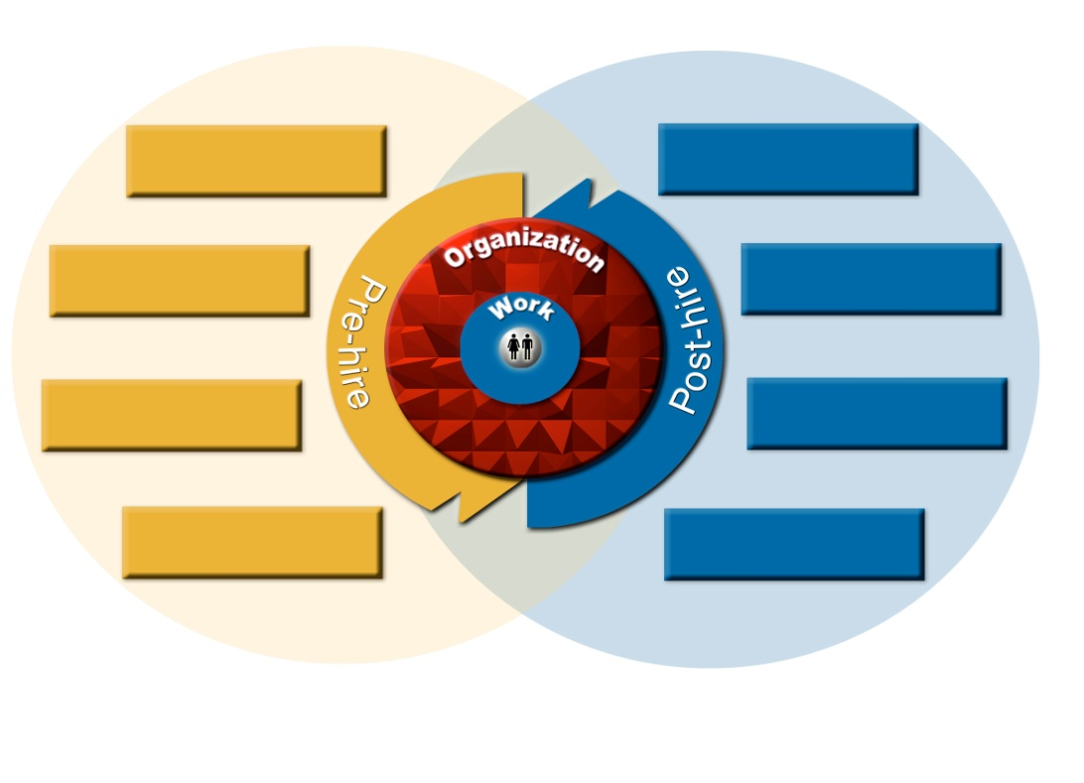
Competency Linkage to HR Processes
Vision and Values
Business Plan and Challenges
Competitive Advantage
Organization Structure and Roles
Operational Excellence
Leadership Competency
Functional Competency
Critical Behaviour
Knowledge
Application
Leadership Proficiency
Functional Proficiency
HR Strategy
Succession Planning
Overall Individual Proficiency
Role Definition & Job Profiling
Training &
Development
Individual Development Plan
High Potential Employees
Future Leaders
Career Planning
Talent Pipeline
Sourcing &
Recruitment
Performance
Management
Selection &
Assessment
New Hire Orientation

Slide 10
Competency Application to Big Picture
Career Development
E Learning
Coaching and Mentoring
Technical Training Centre
All Participants
Competency Assessment
Individual Development Plan
High Potentials
Those who have not qualified for OA
Business Academy
On the Job Projects
Job Posting
Applicant Evaluation
Career Moves
Vacancies
Job Description
Profile Description
Past Performance
Experience in Current Org
Experience in Current Role
Supervisor Comments
ADC Inputs

Slide 11
Implementation Calendar - Illustrative
NO | MILESTONE | For Illustration
 |  | Sep | Oct | Nov | Dec | Jan | Feb | Mar | Apr | May | Jun | Jul | Aug | Sep
1 | Organization Brief (Study of Structure & Roles)
2 | Mapping Functional Competencies
3 | Mapping Behavioural Competencies
4 | Dictionary Development
5 | Assessment Preparation
6 | Assessment
7 | Report Presentation
8 | IDP Preparation

Slide 12
Count on our support..
As mentioned earlier the purpose of this document is to only provide clarity on ‘how and where CareerTree can facilitate and add value’ to the initiative of Competency Based Management.
CareerTree has the expertise and experience of handling this initiatives for the last eleven years in India as well as in abroad across the industrial sector.

Slide 13
13
Call us at..
For more information, please contact
CareerTree HR Solutions Pvt. Ltd
# 4, 3rd Cross Street,
Shenoy Nagar,
Chennai - 600030
Tamil Nadu, India
Tel : +91 44 49004900
Mobile : +91 8884555905, +91 8754544021
E_Mail : karthik@career-tree.in, raji@career-tree.in
Web : www.career-tree.in
Chennai ▪ Bangalore ▪ Hyderabad ▪ Pune ▪ Ahmedabad ▪ Gurgaon ▪ Rudrapur ▪ Kolkata

Slide 14
Reference Document

Slide 15
ROLE DEFINITION (Convert Designations to Roles)
ROLE TITLE | DESCRIPTION
FUNCTIONAL LEADER | Is the head of the function; takes accountability for the results of the whole function
FUNCTIONAL COORDINATOR | Handles multiple tasks in a function; his role cuts across many processes of the function; largely performs the coordination role at the functional level
PROCESS OWNER | Handles the complete stretch of a particular process and is responsible for the deliverables of the process
PROCESS EXECUTOR | Is the person responsible for actioning of all plans and decisions by performing by himself or involving the team assigned
Unique Roles
Sn | Departments | Number of Unique positions | Designation of Role Holder | Unique Role
1 | Quality Assurance Function | 13 Employees = 6 Unique Roles In QA Dept. | Dy. Manager - QA. | Process Owner – QA
 |  |  | Executive – QA | Process Executor – QA
 |  |  | Executive – QA | Process Executor – QA
 |  |  | Executive – QA | Process Executor – QA
2 |  |  | Manager – QA | Process Coordinator - QA
 |  |  | Manager – QA | Process Coordinator – QA
 |  |  | Sr.Manager – QA | Process Coordinator – QA
 |  |  | Graduate Engineer Trainee | Trainee – QA
3 |  |  | DGM- QA (Chains) | Functional Leader – QA
 |  |  | Sr.Manager – QA | Process Coordinator – QA
 |  |  | Manager – QA | Process Coordinator – QA
 |  |  | Senior Manager – QA | Process Coordinator – QA
 |  |  | DGM - QA & Vendor Management | Process Owner – QA & Vendor Mgmt
Illustration Only

Slide 16
Map Competencies
Leadership Levels | Business | People | Execution
Managing Self (up to Dy. Mgr) | Innovation | Developing Self | Systems Orientation
 | Customer Orientation | Teamwork | Result Orientation
Managing Team (Mgr to DGM) | Business Focus | Team Leadership | Planning & Organizing
 | Managing Customers | Interpersonal Relationship | Resource Management
Managing Business (GM & Above) | Strategic Orientation | Coaching | Decision Making
 | Building Customer Relationship | Impact & Influence | Setting Standards
Functional
Quality Assurance
Role-Competency Matrix
Competency / Role |  | Functional Leader - QA | Functional Coordinator - QA | Process Owner - QA & QS | Process Executor - QC
1 | QA Planning & Coordination | x | x | x | x
2 | Testing of Samples |  | x | x | x
3 | Customer Technical Support | x | x | x | x
4 | Quality Management System | x | x | x | x
5 | Manufacturing Orientation |  |  |  | x
6 | Manufacturing Process Management | x | x | x
7 | New Product Development | x | x | x
8 | Supplier Quality Management | x
9 | Systems Orientation | x | x | x | x
Illustration Only
Behavioural

Slide 17
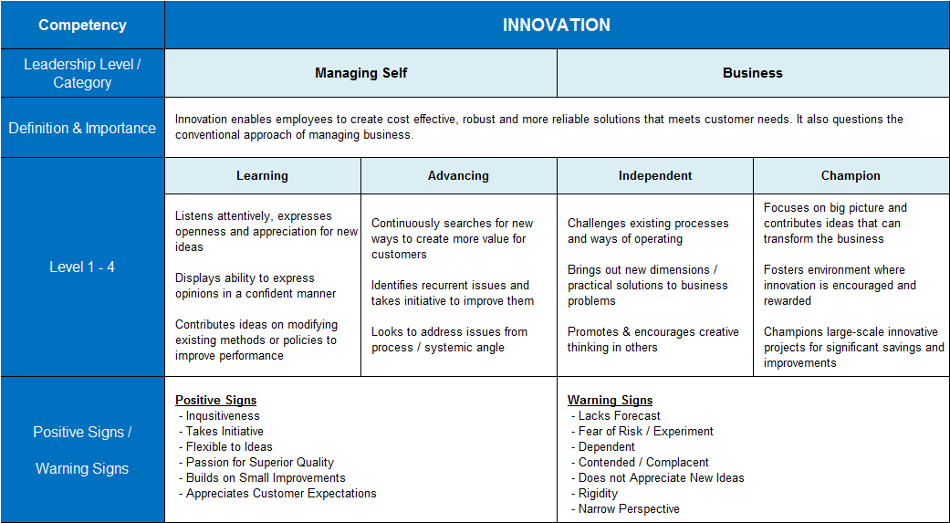
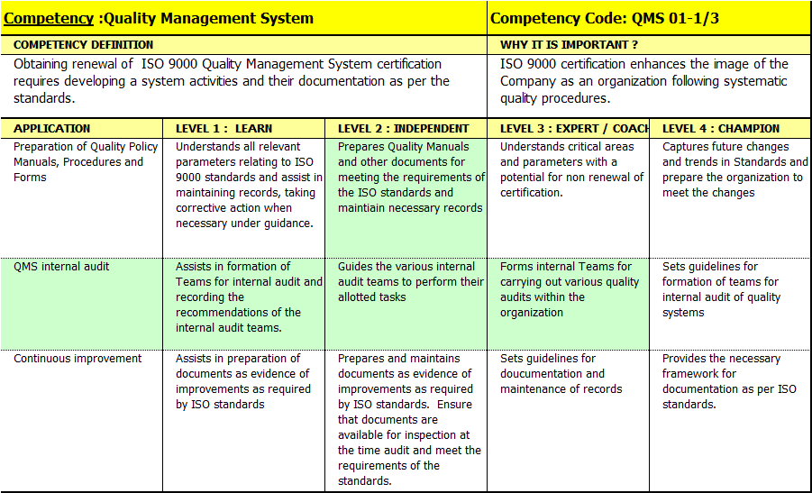
Create Competency Dictionary
Illustration Only

Slide 18
Define Required Proficiency Levels (RPL)
Quality Assurance – Functional Competencies
Required Proficiency Level
Competency / Role |  | Functional Leader - QA | Functional Coordinator - QA | Process Owner - QA & QS | Process Executor - QC
1 | QA Planning & Coordination | 4 | 3 | 3 | 2
2 | Testing of Samples | - | 3 | 3 | 2
3 | Customer Technical Support | 4 | 3 | 3 | 3
4 | Quality Management System | 3 | 3 | 2 | 2
5 | Manufacturing Orientation | - | - | - | 3
6 | Manufacturing Process Management | 4 | 3 | 3 | -
7 | New Product Development | 3 | 3 | 1 | -
8 | Supplier Quality Management | 3 | - | - | -
9 | Systems Orientation | 3 | 3 | 2 | 2
Leadership Competencies
Required Proficiency Level
Competency / Role |  | E1 | E2 | F1 | F2
1 | Innovation | - | - | 3 | 2
2 | Customer Orientation | - | - | 4 | 3
3 | Team Work | - | - | 3 | 3
4 | Systems Orientation | - | - | 3 | 2
5 | Business Focus | 4 | 3 | - | -
6 | Managing Customers | 4 | 3 | - | -
7 | Team Leadership | 3 | 2 | - | -
8 | Planning & Organizing | 3 | 2 | - | -
Illustration Only

Slide 19
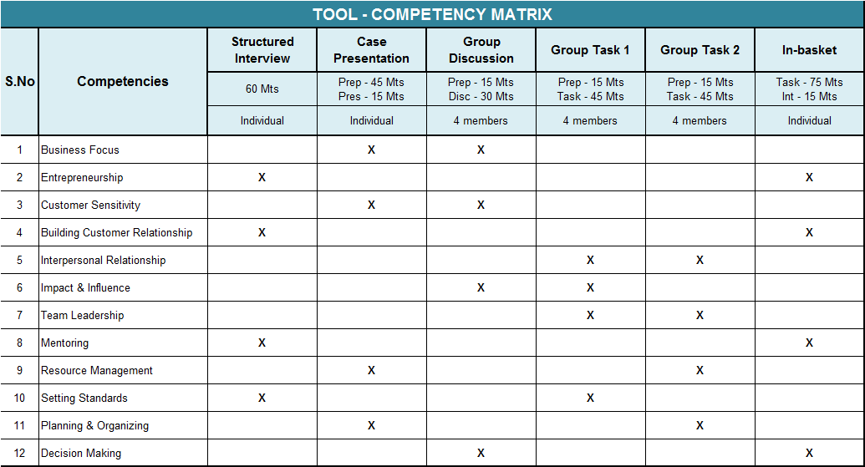
Create Assessment Tools
Illustration Only

Slide 20
Conduct Assessment
Competencies Rating / Participants |  | Vineet (F1) | Ramesh (F1) | Ganesh (F1) | Shailaja (F2) | Vijay (F2) | Pushpa (F2) | Sanjay (F2)
Innovation | RPL | 3.00 | 3.00 | 3.00 | 2.00 | 2.00 | 2.00 | 2.00
 | CPL | 2.00 | 2.00 | 1.00 | 1.00 | 2.00 | 1.00 | 1.00
Customer Service Orientation | RPL | 4.00 | 4.00 | 4.00 | 3.00 | 3.00 | 3.00 | 3.00
 | CPL | 3.00 | 2.00 | 2.00 | 3.00 | 2.00 | 2.00 | 2.00
Team Work | RPL | 3.00 | 3.00 | 3.00 | 3.00 | 3.00 | 3.00 | 3.00
 | CPL | 2.00 | 2.00 | 2.00 | 1.00 | 2.00 | 2.00 | 1.00
Systems Orientation | RPL | 3.00 | 3.00 | 3.00 | 2.00 | 2.00 | 2.00 | 2.00
 | CPL | 1.00 | 3.00 | 2.00 | 2.00 | 2.00 | 1.00 | 2.00
Avg Leadership Score |  | 2.00 | 2.25 | 1.75 | 1.75 | 2.00 | 1.50 | 1.50
Competencies Rating / Participants |  | Vineet | Ramesh | Ganesh | Shailaja | Vijay | Pushpa | Sanjay
 |  | (F1) | (F1) | (F1) | (F2) | (F2) | (F2) | (F2)
 |  | Process Owner | Functional Coordinator | Process Owner | Process Executor | Process Executor | Process Executor | Process Executor
QA Planning & Coordination | RPL | 3.00 | 3.00 | 3.00 | 2.00 | 2.00 | 2.00 | 2.00
 | CPL | 2.00 | 1.00 | 1.00 | 1.00 | 1.00 | 1.00 | 1.00
Quality Management System | RPL | 2.00 | 3.00 | 2.00 | 2.00 | 2.00 | 2.00 | 2.00
 | CPL | 2.00 | 2.00 | 2.00 | 2.00 | 1.00 | 1.00 | 2.00
Customer Technical Support | RPL | 3.00 | 3.00 | 3.00 | 3.00 | 3.00 | 3.00 | 3.00
 | CPL | 1.00 | 2.00 | 1.00 | 1.00 | 1.00 | 1.00 | 1.00
Systems Orientation | RPL | 2.00 | 3.00 | 2.00 | 2.00 | 2.00 | 2.00 | 2.00
 | CPL | 1.00 | 3.00 | 2.00 | 2.00 | 2.00 | 1.00 | 2.00
Avg Functional Score |  | 1.50 | 2.00 | 1.50 | 1.50 | 1.25 | 1.00 | 1.50
Illustration Only

Slide 21
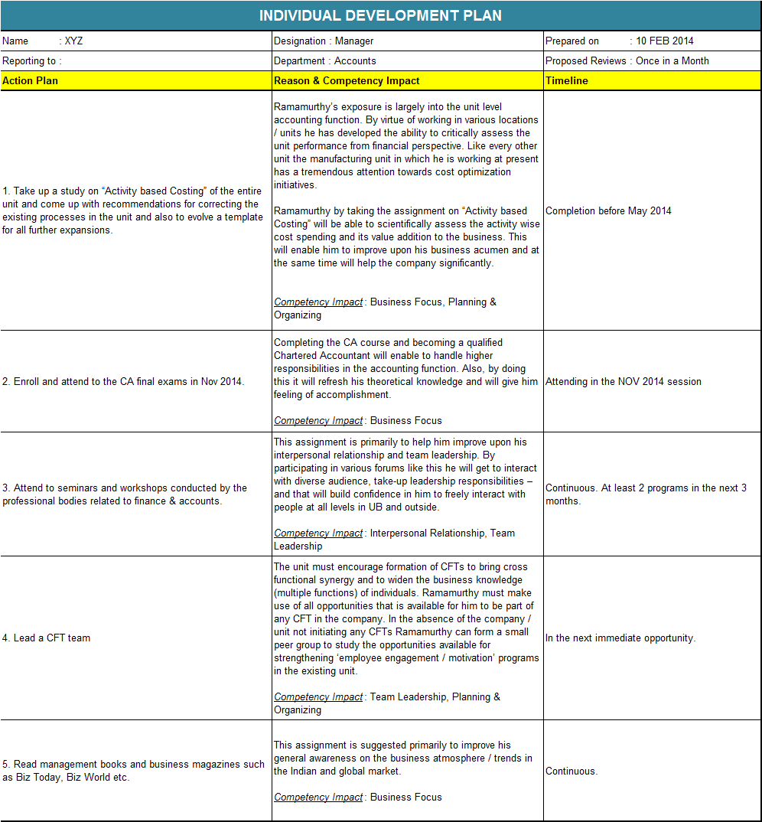
Create Individual Development Plan
Illustration Only

